Slide 1

Customer Shopping Behavior Analysis
Key insights and business recommendations for marketing and product teams.

Slide 2

3,900 Purchases Analyzed
18 Features
PostgreSQL
Dataset spans customer demographics, purchase details, and shopping behavior
Cleaned and integrated for comprehensive SQL analysis
3,900 Records
Full transaction-level data powering every insight in this report

Slide 3

CHAPTER
Key Findings
What the data reveals about who is buying, what they buy, and how they behave.

Slide 4
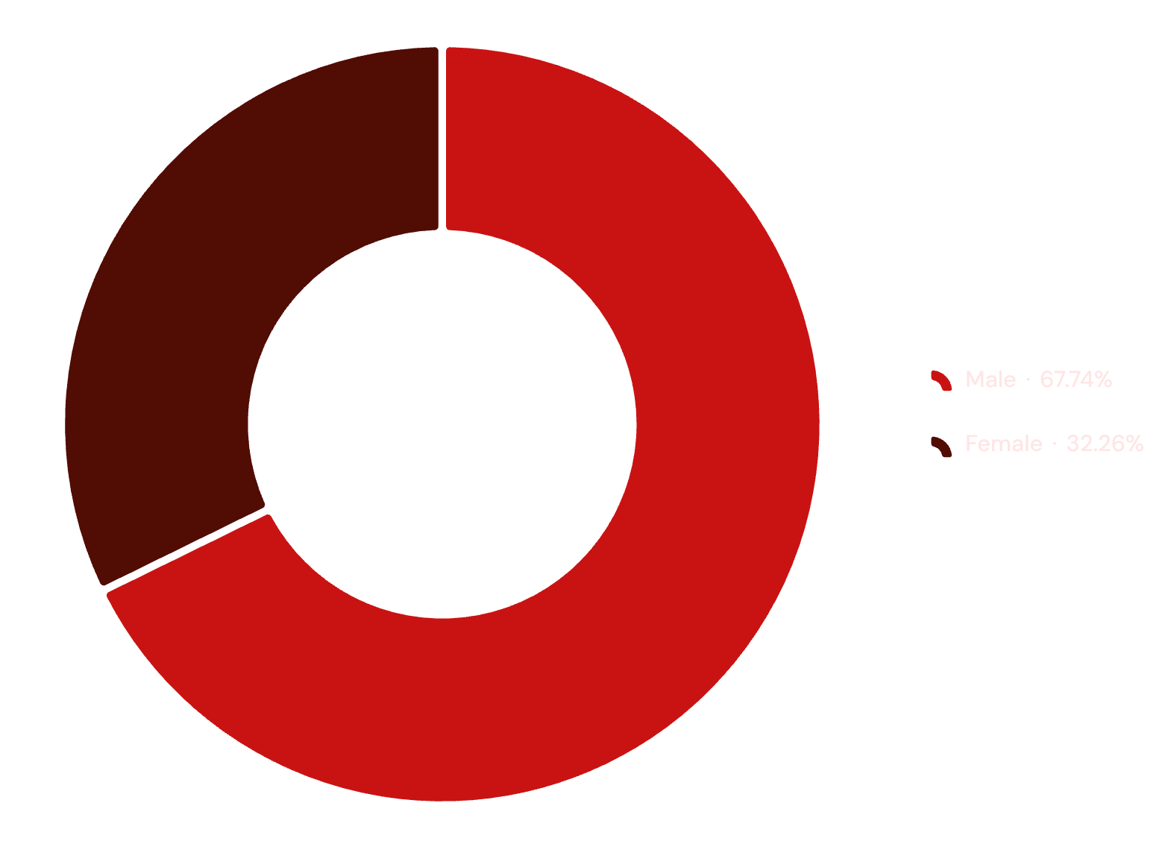

Revenue Skewed Toward Male Customers
A Significant Revenue Gap
Male customers account for $157,890 — 68% of total revenue, while female customers generate $75,191 (32%).
This near 2:1 imbalance signals an underserved segment with meaningful growth potential.
Opportunity: Develop targeted campaigns to increase female customer engagement and spending.

Slide 5
Loyal Customers Dominate the Base
80%
18%
2%
Loyal
Returning
New
3,116 customers — the bedrock of the business
701 customers with repeat purchase intent
Only 83 new customers — acquisition is a gap
The customer base is heavily retention-driven. While loyalty is a strength, the near-absence of new customers signals that acquisition strategies need urgent attention.

Slide 6
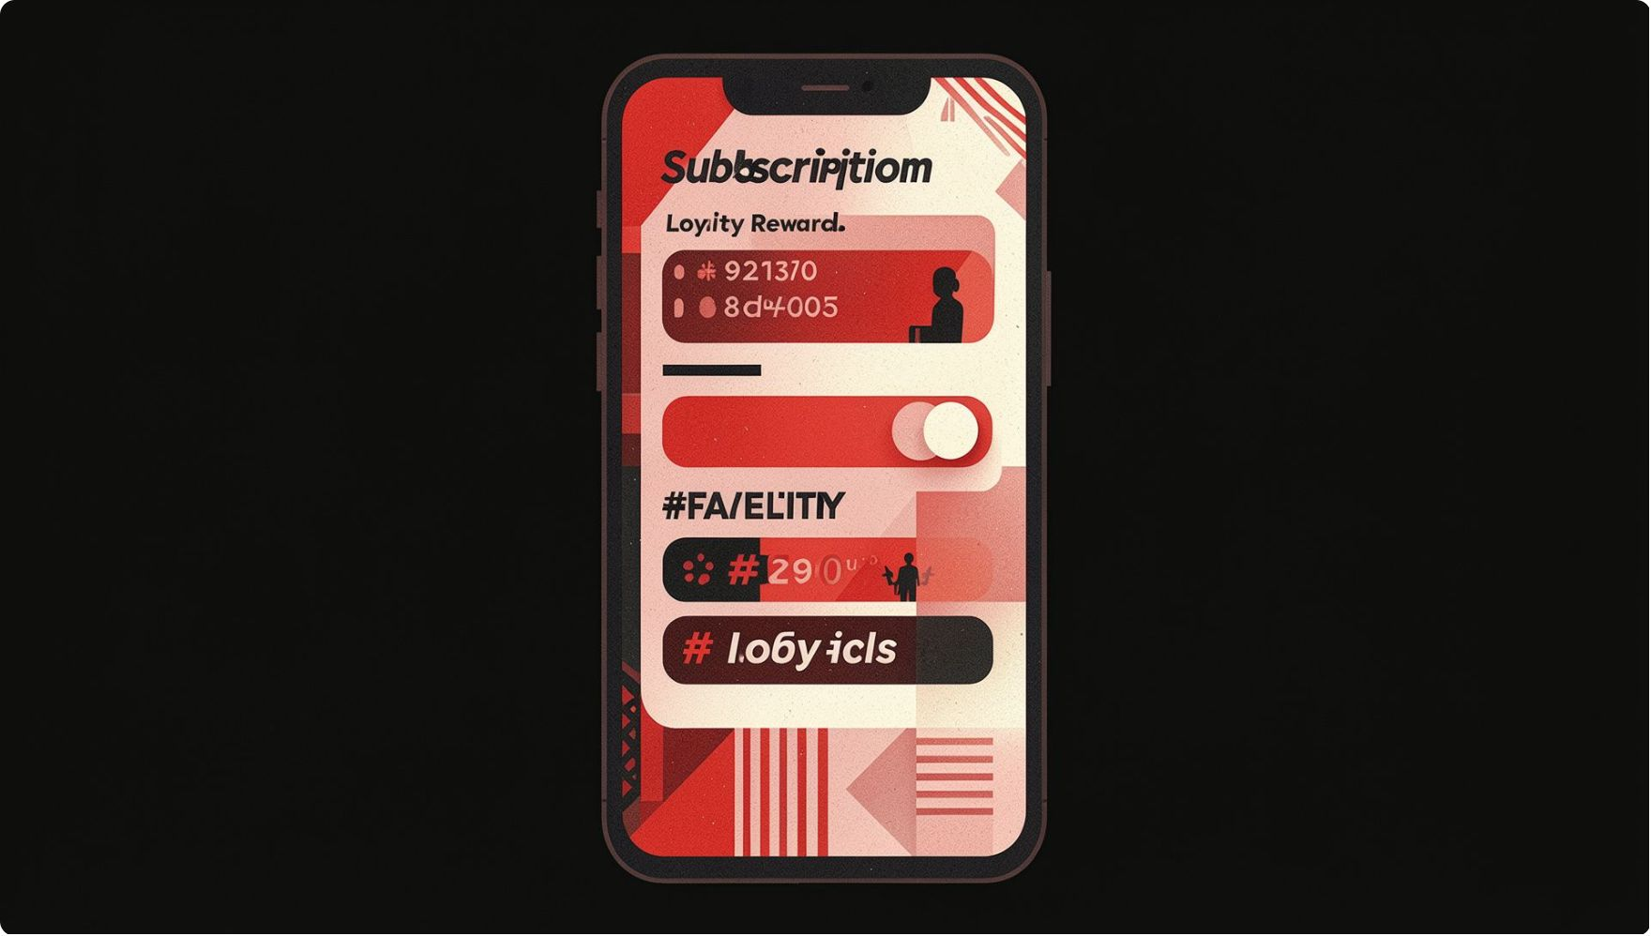

Subscription Adoption Lags
Only 27% of customers hold an active subscription — just 1,053 of 3,900.
Counterintuitively, subscribers spend slightly less on average ($59.49) than non-subscribers ($59.87), suggesting the subscription model is not currently driving incremental spend.
The subscription model needs repositioning to justify adoption and deliver measurable value.

Slide 7
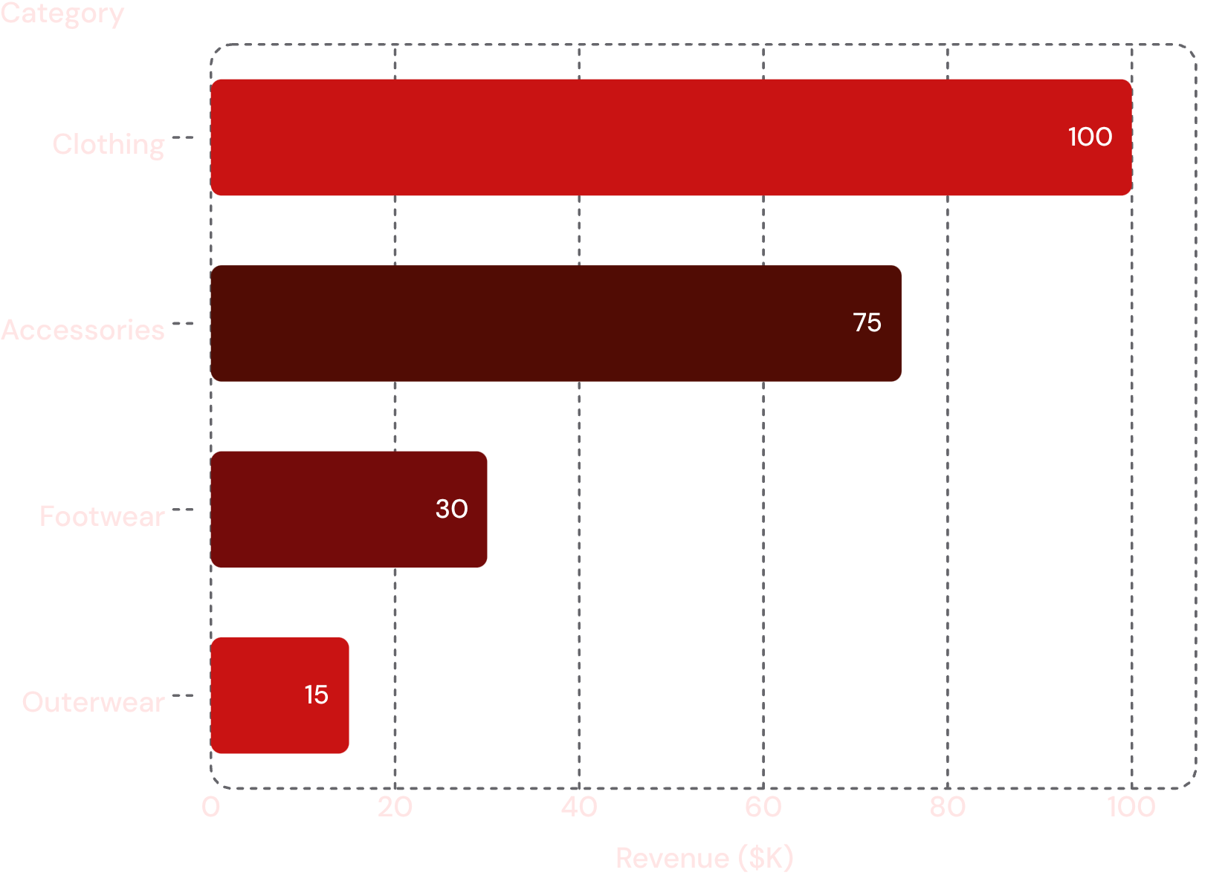
Clothing Dominates Revenue
Category Breakdown
Clothing leads with ~$100K — 56% of total revenue
Accessories contribute ~$75K (42%), making it a strong secondary category
Footwear & Outerwear combined account for only ~$45K (2%) — an area to monitor or invest in
The concentration in two categories creates both opportunity and risk. Diversifying footwear and outerwear performance could meaningfully expand revenue.

Slide 8

Top-Rated Products Drive Loyalty
⭐ Top Rated
👕 Clothing Leaders
Gloves (3.86★), Sandals (3.84★), Boots (3.82★) lead in customer satisfaction scores
Blouse, Pants, and Shirt are the highest-volume sellers in the Clothing category
💍 Accessories Leaders
Jewelry, Sunglasses, and Belt top the Accessories category by sales volume

Slide 9
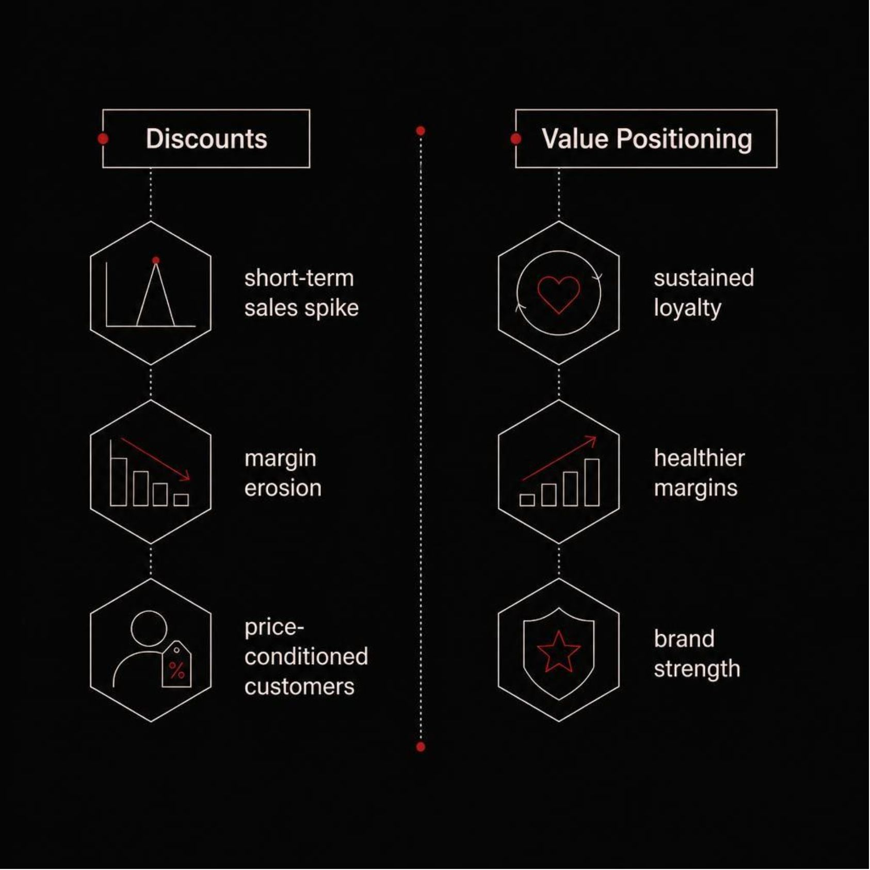

Discounts Drive Sales, Not Loyalty
High Discount Dependency
Hat: 50% of purchases used a discount
Sneakers: 49.66% discount rate
Coat: 49.07% discount rate
839 customers spend above average even when discounts are applied — a signal that value perception exists, but it is being trained on price cuts rather than product merit.
Over-reliance on discounts risks eroding margins and conditioning customers to wait for sales.

Slide 10
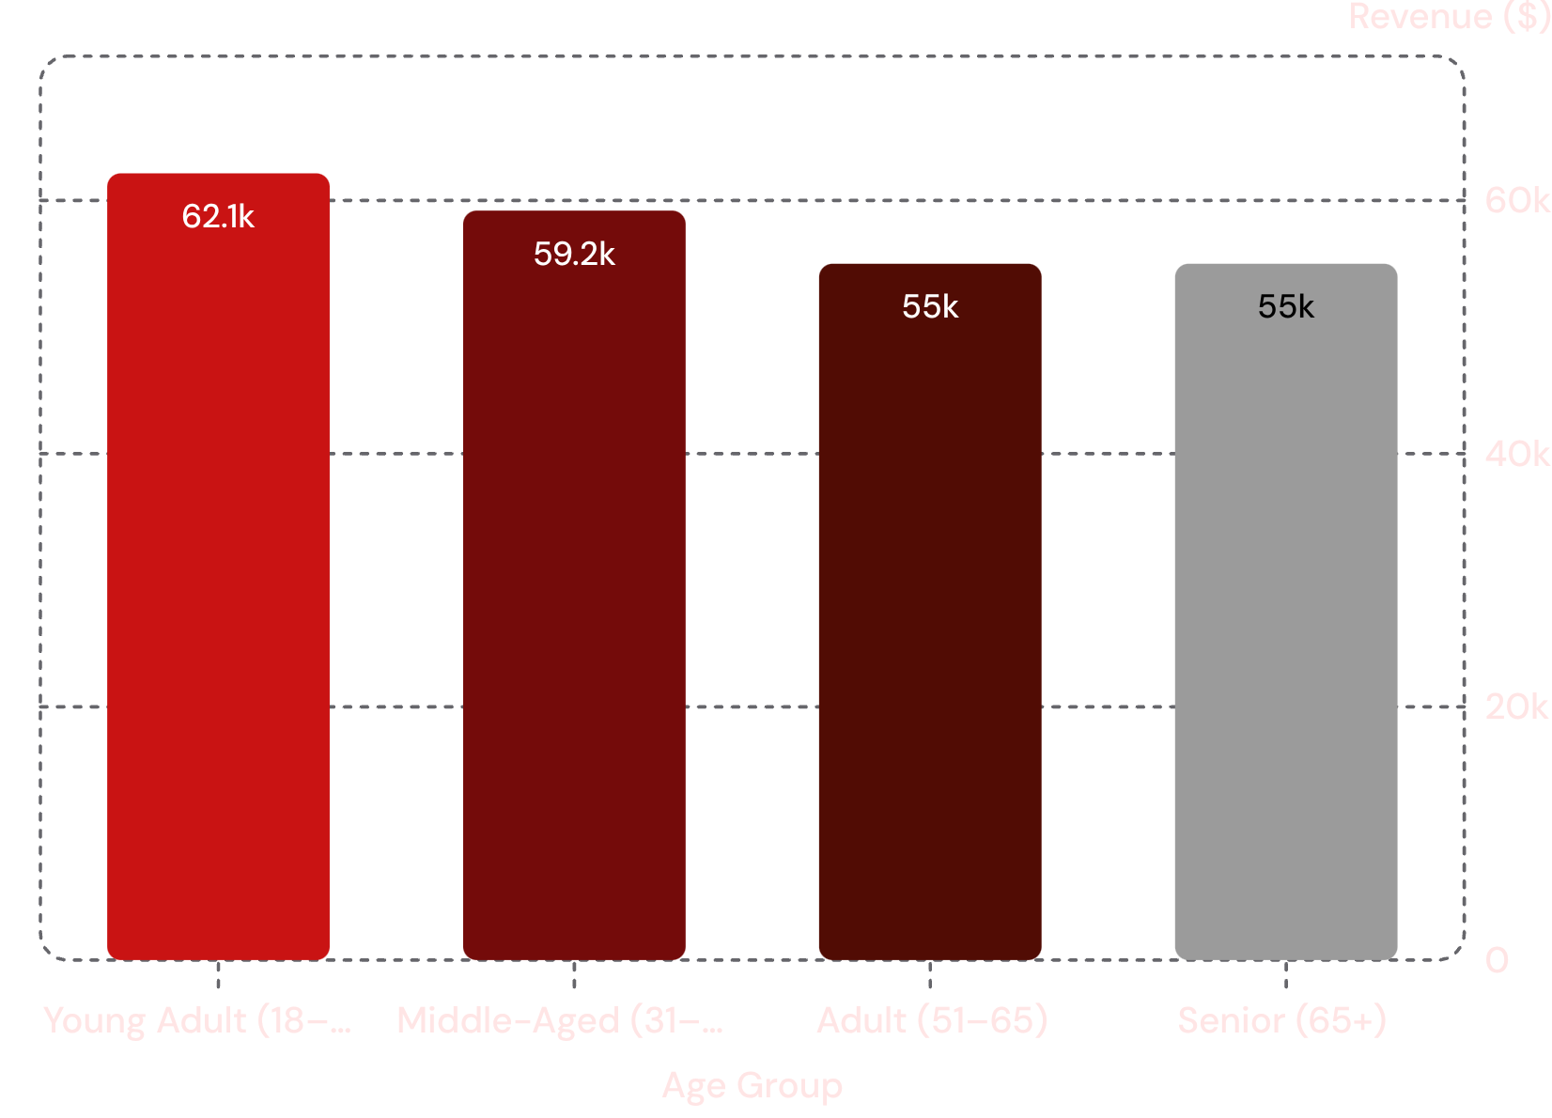
Young Adults Spend Most
A Clear Age Hierarchy
Young Adults (18–30) generate the most revenue at $62,143 — outpacing every other age cohort.
Middle-aged customers follow closely at $59,197, while Adult and Senior segments each contribute approximately $55K.
This distribution suggests marketing investment in the 18–30 segment offers the highest return, while senior outreach remains underexplored.

